Slide 1
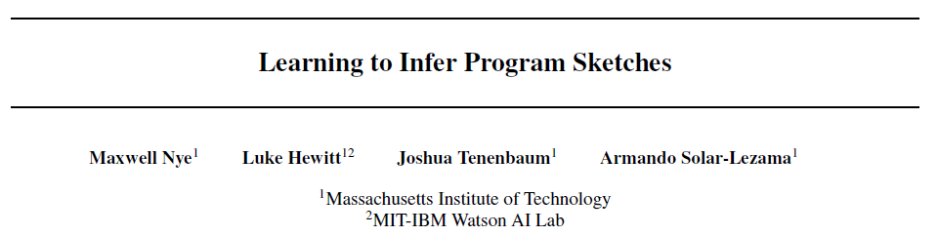
Reporter: Li Qingtao

Slide 2

Observations
“Depending on the familiarity of the domain and the complexity of the problem, humans use a flexible combination of recognition of learned patterns and explicit reasoning to solve programming problems.”
Examples:
filter(input, <HOLE>)
filter(input, lambda x: x%2==0)
“Find the even values in a list.”
“Find values in the list which are powers of two.”

Slide 3
Related work
Murali et al. (2017)
Use static, hand-designed intermediate sketch grammars
This paper proposed a system to dynamically incorporate pattern recognition and symbolic search.
For easy or familiar tasks: fuller program sketch
For hard tasks: less complete sketch

Slide 4
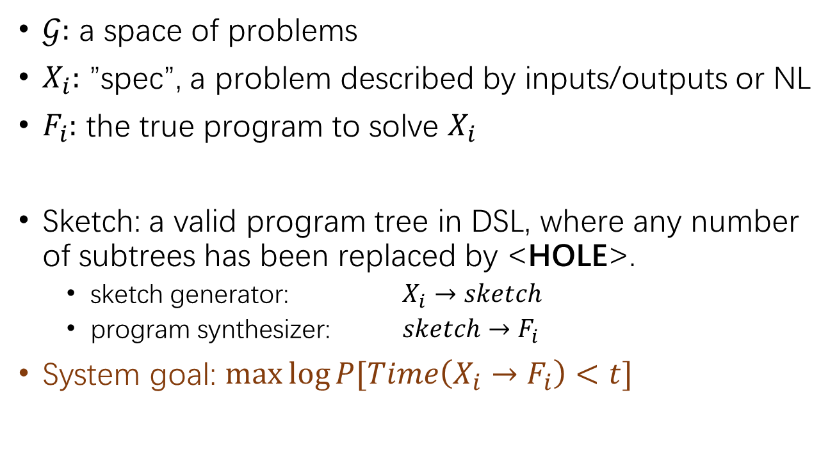
Formulation & System overview
$𝒢:$ a space of problems
$X_{i}:$ ”spec”, a problem described by inputs/outputs or NL
$F_{i}:$ the true program to solve $X_{i}$
Sketch: a valid program tree in DSL, where any number of subtrees has been replaced by <HOLE>.
sketch generator: $X_{i}→sketch$
program synthesizer: $sketch→F_{i}$
System goal: $\max{\log{P[Time\left(X_{i}→F_{i}\right)<t]}}$
Notes:
<HOLE>意味着这个部分的模式识别是困难的，需要进行symbolic search

Slide 5
Formulation & System overview
Notes:
<HOLE>意味着这个部分的模式识别是困难的，需要进行symbolic search

Slide 6
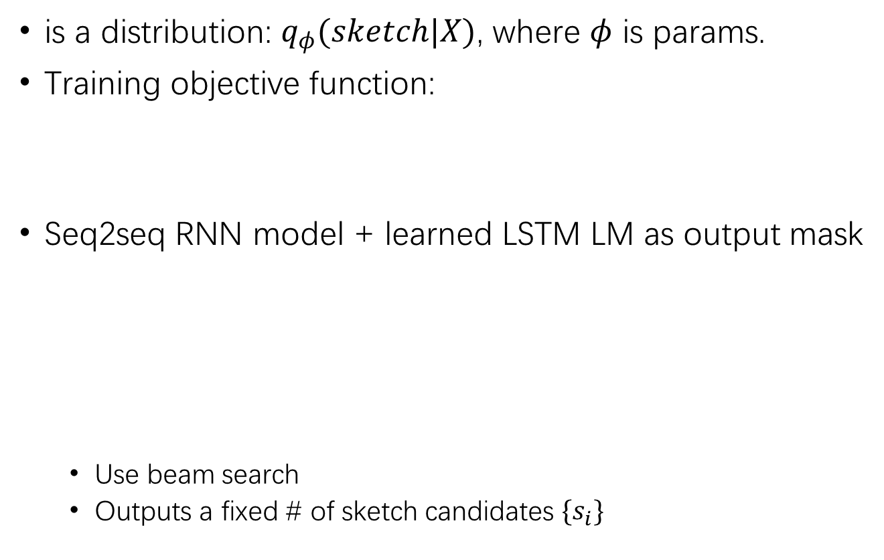
Sketch Generator
is a distribution: $q_{φ}(sketch|X)$, where $φ$ is params.
Training objective function:
Seq2seq RNN model + learned LSTM LM as output mask
Use beam search
Outputs a fixed # of sketch candidates $\{s_{i}\}$
(Devlin et al., 2017)
Inspired by (Bunel et al., 2018)
Notes:
在Devlin2017中，IO使用字符级别LSTM，P使用token级别LSTM

Slide 7
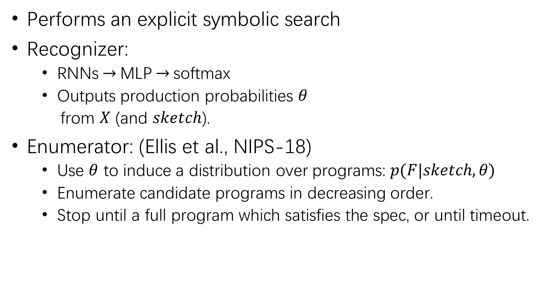
Program Synthesizer
Performs an explicit symbolic search
Recognizer:
RNNs$→$MLP$→$softmax
Outputs production probabilities $θ$
from $X$ (and $sketch$).
Enumerator: (Ellis et al., NIPS-18)
Use $θ$ to induce a distribution over programs: $p(F|sketch, θ)$
Enumerate candidate programs in decreasing order.
Stop until a full program which satisfies the spec, or until timeout.
概率上下文无关文法
Notes:
production probabilities生成概率，构成了“概率上下文无关文法”的参数

Slide 8
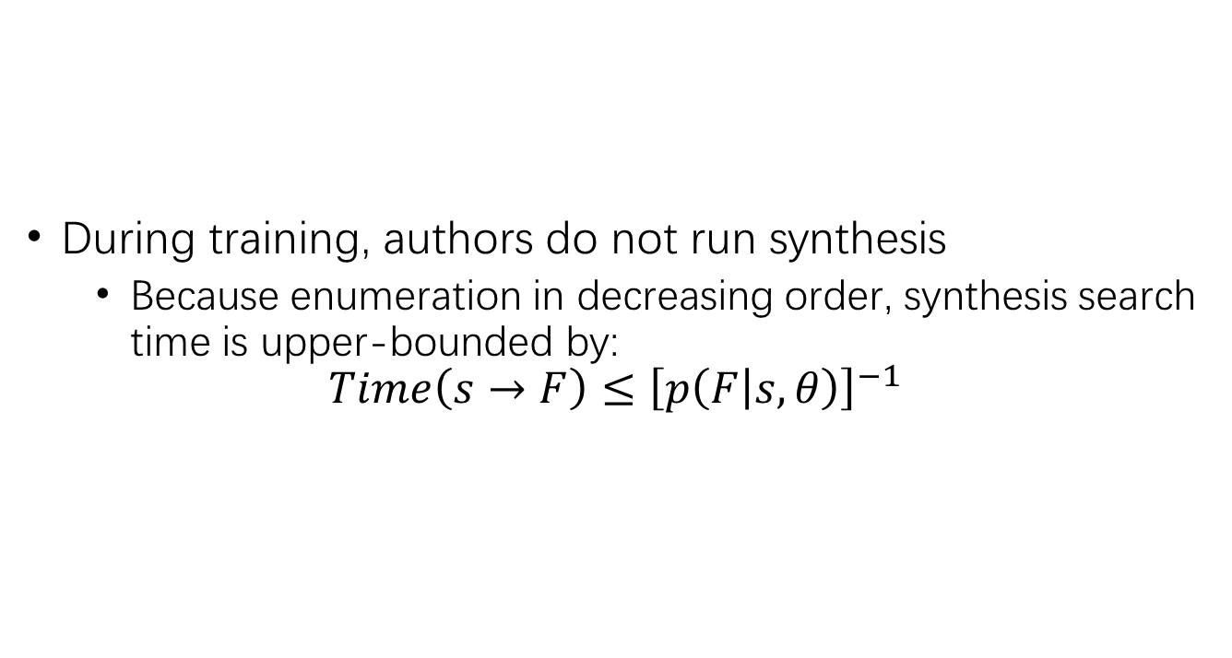
Training
During training, authors do not run synthesis
Because enumeration in decreasing order, synthesis search time is upper-bounded by:
$$Time\left(s→F\right)≤{\left[p\left(F | s, θ\right)\right]}^{−1}$$

Slide 9
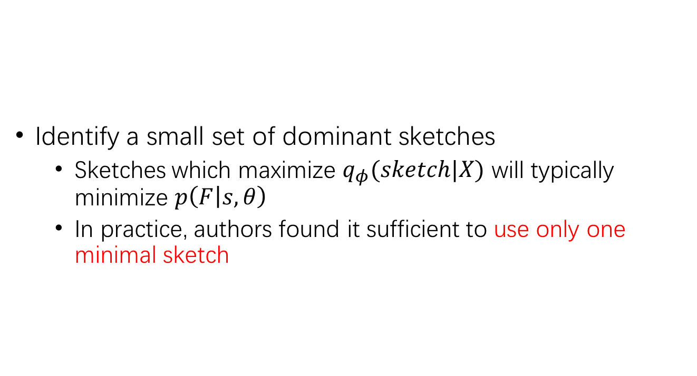
Training
Identify a small set of dominant sketches
Sketches which maximize $q_{φ}(sketch|X)$ will typically minimize $p\left(F | s, θ\right)$
In practice, authors found it sufficient to use only one minimal sketch

Slide 10











Training
$1$.0
$${sketch}_{1}$$
$${sketch}_{2}$$
$${sketch}_{3}$$
$${sketch}_{4}$$
$${sketch}_{5}$$
$$t^{−1}$$
$${sketch}_{6}$$
$0$.0
$${sketch}_{7}$$
$$p\left(F | s, θ\right)$$
Notes:
这个平衡应该是实现motivation的要点之一

Slide 11
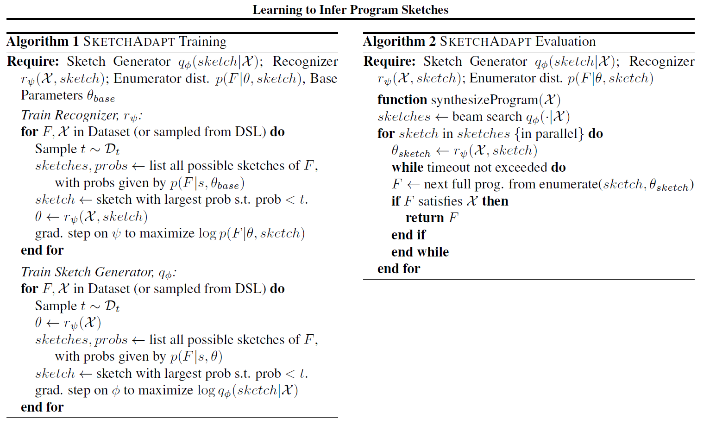


Algorighm
smallest prob s.t. $\text{prob} \text{>} t^{−1}$
smallest prob s.t. $\text{prob} \text{>} t^{−1}$

Slide 12
Experiments
Models
SketchAdapt
Synthesizer only: enumerate programs from a single <HOLE>
(comparable to “DeepCoder”)
Generator only: use sketch generator to predict the entire program
(comparable to (Devlin et al., 2017))
Tasks
List Processing: use DeepCoder dataset
String Transformations: use SyGuS and (Ellis 2018) dataset
Algolisp: Polosukhin & Skidanov (2018)

Slide 13
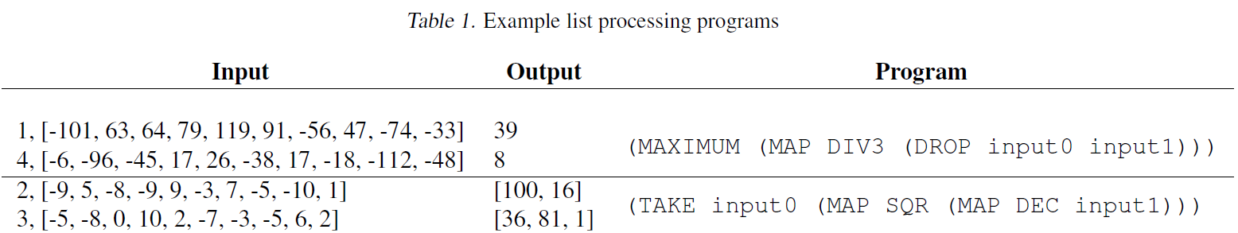
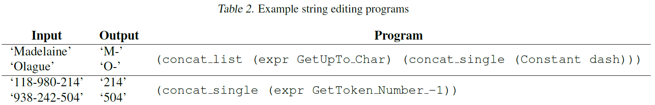
Experiments
Task examples

Slide 14
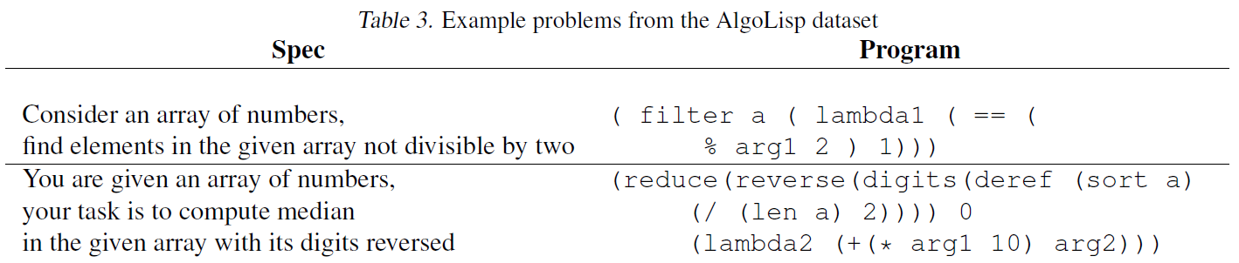
Experiments
Task examples

Slide 15
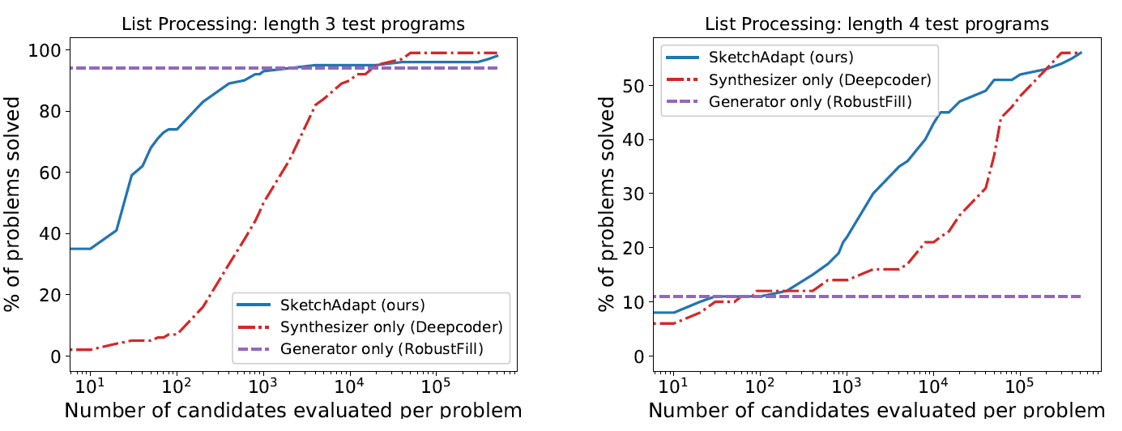
List Processing
Trained on programs of length 3, evaluated on length 3/4
Beam size 100; 5 input/output pairs per problem
Notes:
数据中有34种基本元素

Slide 16
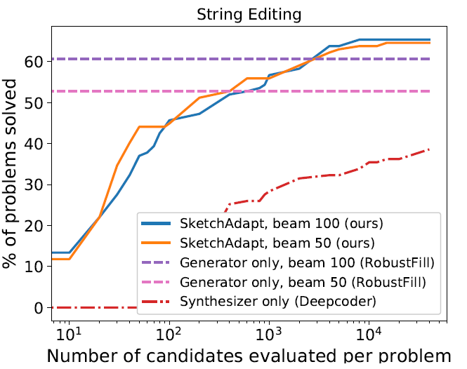
String Transformations
“We trained our model using self-supervision, sampling training programs randomly from the DSL”.
Evaluate on SyGus/Ellis2018 dataset.
4 input/output pairs per problem
Notes:
DSL用的可能是Gulwani2011定义的，但没有明确说明。
受beam size影响小；超过了专为这一任务设计的RobustFill

Slide 17
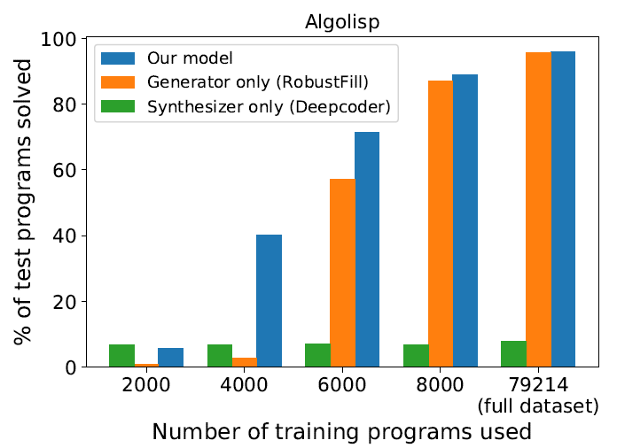
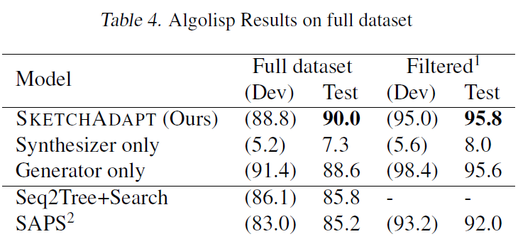
AlgoLisp
Set timeout = 300 seconds (how many candidates?), beam size = 10
Notes:
Symbolic search allows SketchAdapt to perform stronger generalization

Slide 18
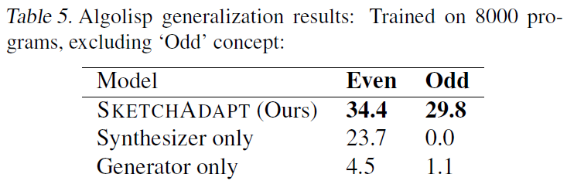

AlgoLisp
Generation test:
Trained on 8000 random programs NOT containing the function “odd”: $lambda (==\left(\% arg1 2\right) 1))$
Evaluate on all 635 programs containing “odd” and 638 containing “even”: $lambda (==\left(\% arg1 2\right) 0))$
Notes:
Filter：原数据集中有program和spec不匹配的情况…

Slide 19
总结
从实验结果看，synthesizer确实能够辅助正确程序的生成
通过运行时间来控制generator与synthesizer的平衡
没有与neural sketch learning的对比
Notes:
虽然用随机采样提高了一些灵活性，但还是不够直接

